Slide 1
Immersion Project Paper
Rogike Britton
Walden University
Humn-6200 Cross Cultural Ethics in Human & Social Services
November 2, 2018

Slide 2
Immersion Project
Muslim and Veganism

Slide 3
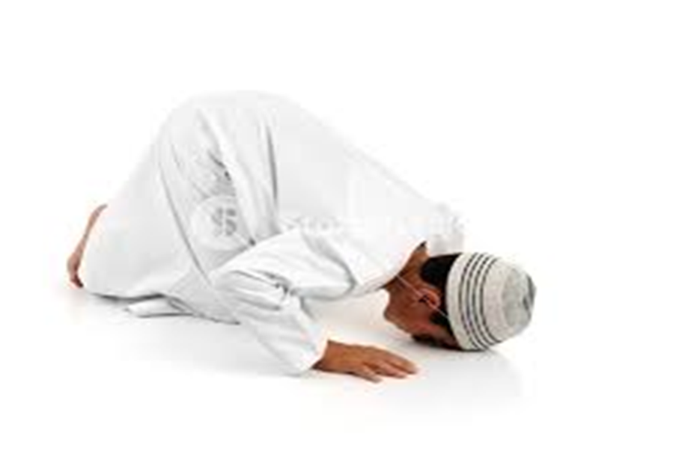
Introduction
A Muslim refers to a person who follows or practices Islam (Watt, 2017).
Muslims consider Quran as their holy book
The majority of the Muslim community follow the teachings and practices of Muhammad.
Veganism is the practice of abstaining from the use of animal products, specifically in diets.
A vegan is a follower of the practice of abstaining from animal products in diets.

Slide 4
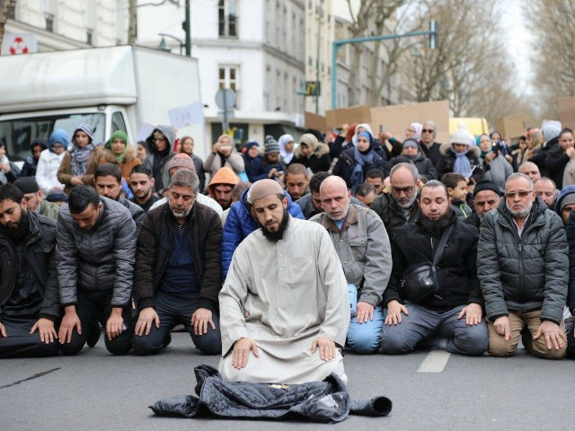
Overview Experiences
Most of the Muslims are friendly people and they do not discriminate against the non Muslims, they value each and every person.
They are viewed as terrorists particularly in most parts in America. However, that is a misconception; they are calm people who value life.
They value their culture and do not shy away from teaching others (Last, 2016).
Through veganism, Muslims protect animals and alienate them from suffering, cruelty and exploitation.

Slide 5
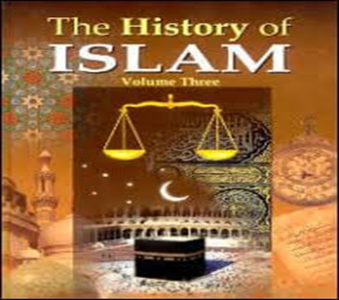
History of Muslims
The history of the Muslim world spans about 1400 years (Lewis, 2017).
It includes a variety of socio-political developments and advances in the arts, science, philosophy and technology, particularly during the Islamic golden age.
The history of Muslim and Islam started in the Arabian Peninsula.
Muhammad, who was the Islamic prophet received Quran’s first revelation in the 7th centuryin the cave of Hira in the month of Ramadan.
The message, according to Islam, came from Allah, and Muhammad was supposed to patiently convey it to the people.

Slide 6
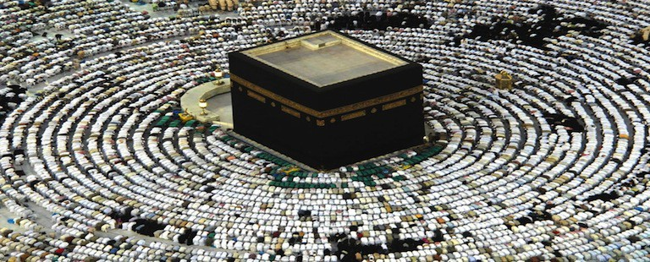
Muslim Culture
Their culture includes the common practices, which are common to Islamic people, for instance, they have a unique way of dressing that reduces the chances of sinning.
Their architect is unique and that is evident going by the nature in which they built mosques.
The presently built mosques were inherited from the first mosque built by Muhammad in Medina (Burke & Inalcik, 2014).
According to the Muslim culture, marriage is a legal bond and social contract between a man and a woman as prompted by Sharia.
Their language and literature depends on the place of origin but early Muslim literature is in Arabic.

Slide 7
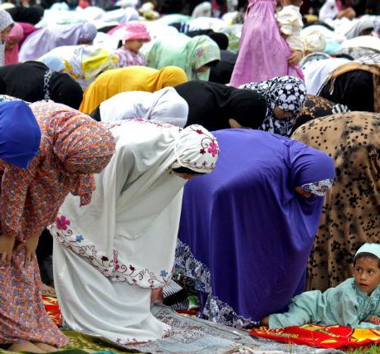
Practices/ Values
They are people who value interactions and relationships. The Muslims ensure that they interact well with their friends and relatives.
To ensure there is unity and the relationships continue to be strong, they regularly visit each other (Bakar, 2018).
Respecting the elders is one key element that young Muslims are taught and they practice that in their entire lives.

Slide 8
Cont…
The Muslims are taught to care for their parents as they are the ones who brought them to this world (Bakar, 2018).
Couples are taught to practice tolerance and must treat their servants well. According to the Quran, mistreating of the servants will lead to the couple going into eternal fire.
The Muslims also practice love in that they love their neighbors even if they are non Muslims.

Slide 9
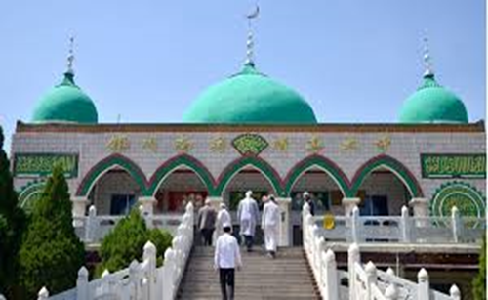
Religious Beliefs
The Muslims believe in one God, that is, Allah. Islam teaches that there is only one God who needs to be served and worshipped.
They also believe in prophets, angels, destiny and judgment day.
They also consider Quran to be the unaltered and final revelation of God.
Muslims hold their prayers at least four times each single day.
Muslims believe fasting is a way of praying, purifying one self and getting closer to God. They fast for up to 17 hours a day, once every year, a period known as the Ramadhan.

Slide 10
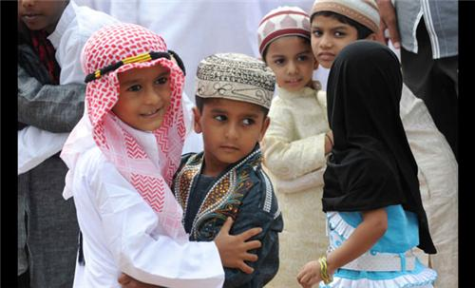
Dress Attire
Muslim and Islam champions for women to cover all their parts when dressing and they should not display their bodies to other people.
Women are required to wear a hijab, which is specially designed to cover the parts that must remain covered (Bakar, 2018)
Muslim women are also required to wear headdresses to cover their hair. Their beauty should only be seen by their families and not any outsider.

Slide 11
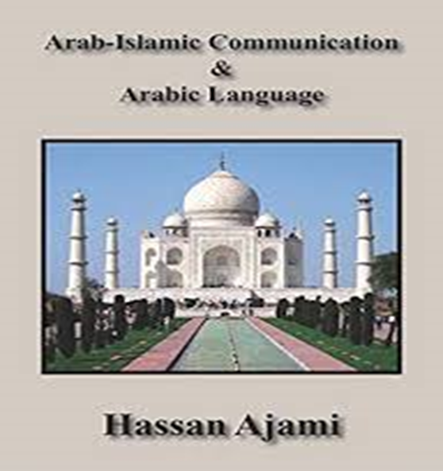
Language and Communication
Muslims around the world majorly communicate in Arabic, which is the universally accepted language among the Muslims.
The holy book of Quran is also written in Arabic and is globally understood.
Prayers are also conducted in Arabic to ensure words are not lost while translating to other languages (Bakar, 2018).
However, Muslims from different places have their distinct way of communicating.

Slide 12

Roles in Muslim
There are distinct roles among the women and men as well as children and adults in Islam (Last, 2016).
Everyone is expected to work as without work, a person is not expected to eat.
Men are expected to provide for their families. the needs of the families are catered for by the men.
Women on the other hand are expected to ensure there are strong family bonds.
Children are expected to respect their elders while adults should guide and be an example to the children.

Slide 13
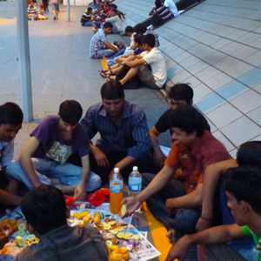
Social Interactions
Relationships and Unity are vital elements in Islam.
Muslims are taught to have good relationships among families and with the outsiders.
They are also taught not to discriminate against the non Muslims and relate well with everybody in the society (Watt, 2017).
Respect is important in every relationship and it should be two way with each person respecting another.
Servants are also important people and should not be mistreated by their Muslim employers.

Slide 14
Conclusion
Muslims are a group that is rich in culture and values.
There should not be stereotypes when describing the Muslims since most of them are good and have excellent values.
Through the project, I learned a lot of things about the Muslim as explained above, and I value and respect them even more.

Slide 15
References
Bakar, F. (2018). Does veganism go against Muslim beliefs? Retrieved from https://metro.co.uk/2018/02/15/does-veganism-go-against-muslim-beliefs-7312122/
Burke, P., & Inalcik, H. (2014). MUSLIM CULTURE. In History of Humanity: Volume V (pp. 242-243). Routledge.
Last, M. (2016). The importance of knowing about not knowing. In On knowing and not knowing in the anthropology of medicine (pp. 19-35). Routledge.
Lewis, I. M. (2017). Islam in tropical Africa. Routledge.
Watt, W. M. (2017). Islamic philosophy and theology. Routledge.

